Slide 1

Applied Machine Learning
HW_1_Estimate_LR_with_Boston_dataset
Group 02 - Alpha Team

Slide 2
Boston house prices dataset
Dependent Variable
Price (target)
Independent Variable
Average number of rooms per dwelling. (RM)
Weighted distances to five Boston employment centers. (DIS)
% lower status of the population.(LSTAT)
1000(Bk - 0.63)^2 where Bk is the proportion of black people by town.(B)
Pupil-teacher ratio by town. (PTRATIO)

Slide 3
State what sign of estimated parameters do you expect and why?
RM parameter (variable) the sign we expected was to be positive.
The more the number of the rooms the more the price becomes.
DIS parameter (variable) the sign we expected was to be positive.
If the Boston house is close to the employment center then the price(target) will increase.
LSTAT parameter (variable) the sign we expected was to be negative.
Higher, lower-status population reduces the price(target) of the house.
B parameter (variable) the sign we expected was to be positive.
The more black people in town the more the price(target) is.
PTRATIO parameter (variable) the sign we expected was to be positive.
The more the pupil-teachers the more the price (target) is.

Slide 4
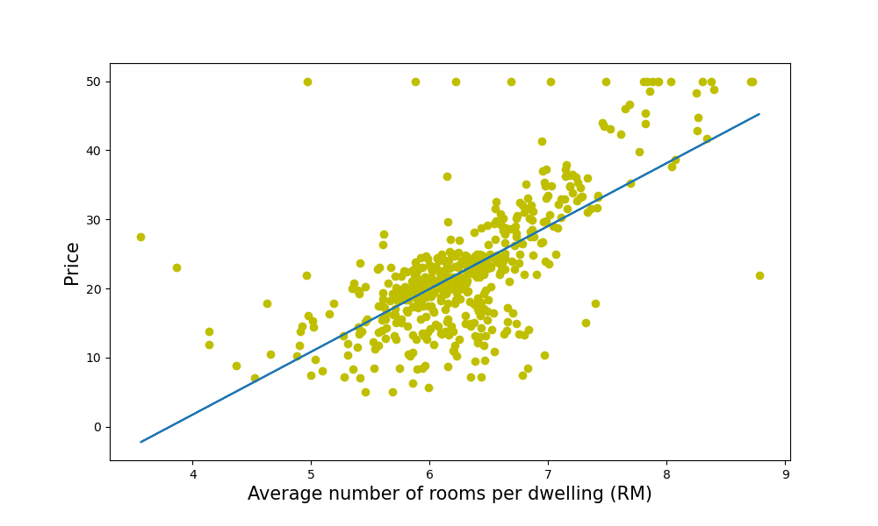
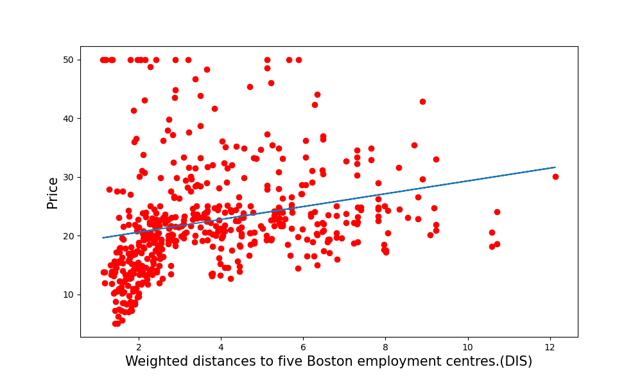
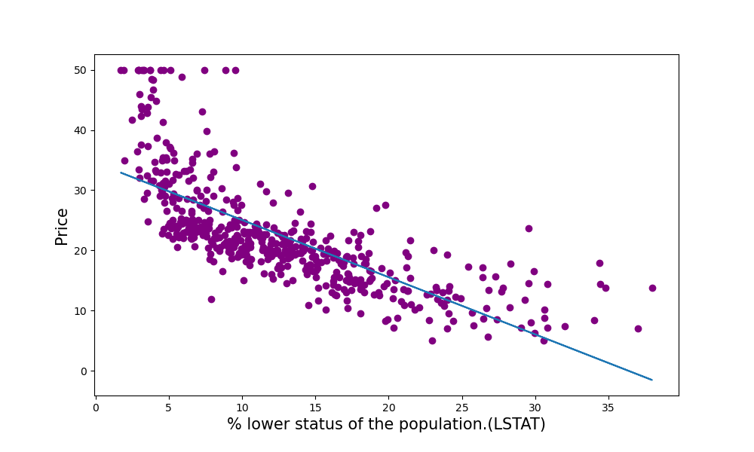
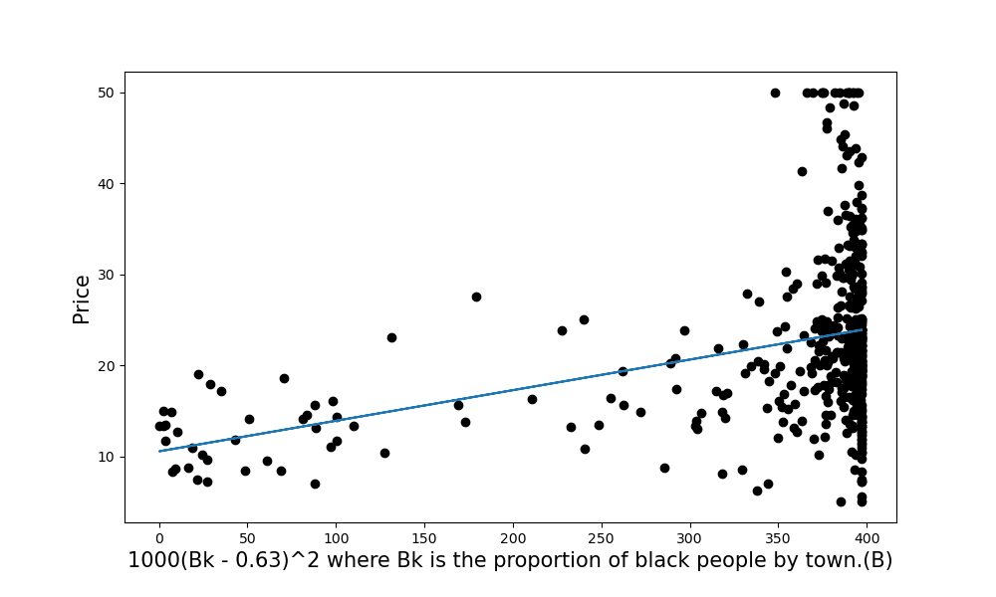
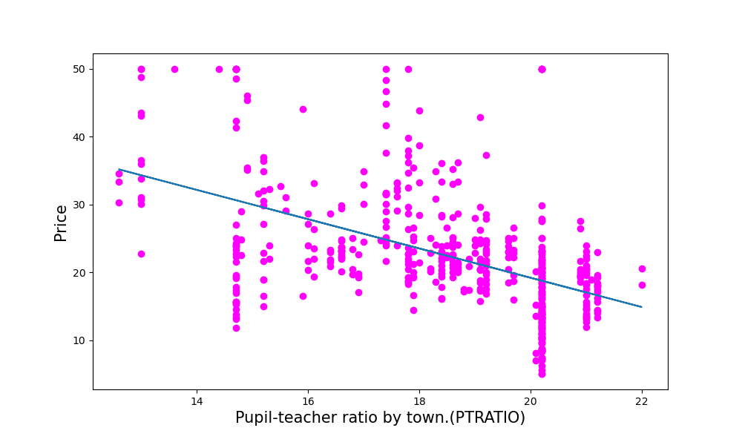
The Data and linear relationships

Slide 5
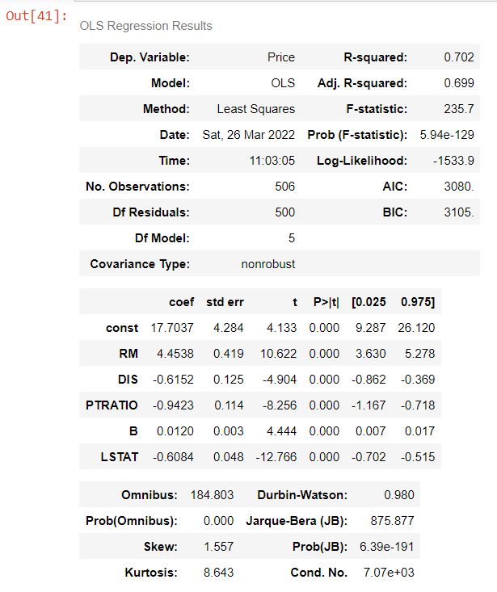
Comment on R2 and statistical significance of estimated parameters ?
Comment on whether your sign expectations (see 2 above) were correct ?
The Adjusted R-Squared is almost 0.7(70%)
On the p-values the independent variables are significant in linear regression if the values are less than 0.05, so in our case it applies to all factors.
We don’t have to treat the estimated values as a zero because our p-values are less than 0.01.
So, for example we can say that higher average number of rooms per dwelling leads to higher price(target).
Our most sign expectation was right. Except on the PTRATIO parameter (variable). We were expecting to become positive but comes out negative.

Slide 6

Thank You

